Slide 1
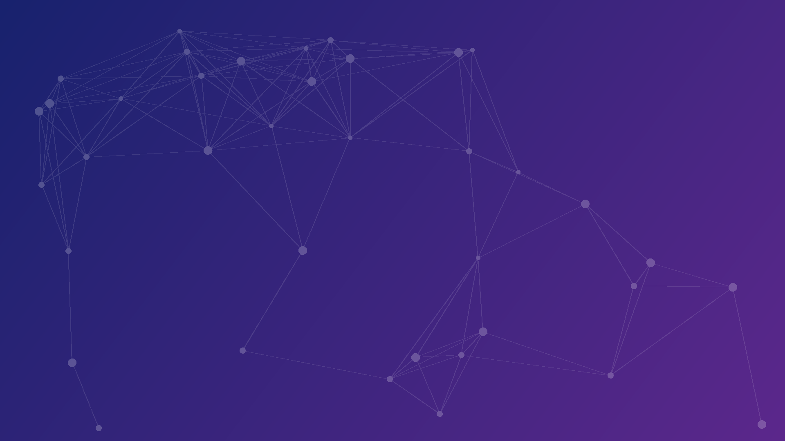



Track 5 – Digital Life Sciences, Health, Agriculture & Biodiversity
11–12 December 2026 · NIELIT Guwahati, Gauhati University Campus
Shortcuts and Temporal Leakage in the Bangalore EEG Epilepsy Dataset
A Provenance Audit and Leakage-Aware Benchmark of Lightweight Seizure-Type Classifiers
Er. Rishabh Aryan
M.Tech (Artificial Intelligence and Data Science),
Department of Computer Science and Engineering,
Indian Institute of Information Technology, Bhagalpur (Bihar)
E-mail: rishabh.250201011@iiitbh.ac.in
ORCID ID: https://orcid.org/0009-0004-7595-9440
NIELIT Bio-AI Conclave 2026
Notes:
Speaker notes: Good morning. I am Rishabh Aryan from IIIT Bhagalpur. This talk presents a provenance audit and a leakage-aware benchmark of the Bangalore EEG Epilepsy Dataset, BEED, and asks how much of its reported performance survives once two shortcuts are removed: the origin of the healthy class and temporal leakage between neighbouring rows.
Sources: Title and subtitle: BEED_paper_camera_ready.docx (title line); Presenter, affiliation, e-mail and ORCID: as supplied by the presenter; Conclave name, Track 5, dates and venue: NIELIT Bio-AI Conclave 2026 call for papers.

Slide 2
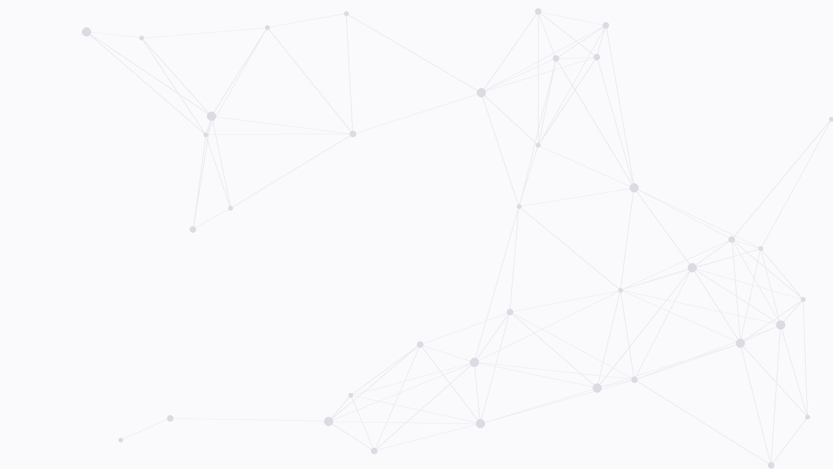


Outline
1. Introduction
Motivation, the BEED dataset, research question
4. Results
Split comparison, model behaviour, edge model
2. Dataset Audit
Healthy-class provenance, temporal leakage
5. Discussion
Limitations of the dataset and the study
3. Methodology
Leakage-safe splits, models and statistical tests
6. Conclusion
Takeaways and future work
NIELIT Bio-AI Conclave 2026 · Track 5
2 / 15
Notes:
Speaker notes: The talk has six parts. I first introduce the motivation, the BEED dataset and the research question. Then I present the dataset audit: where the healthy class comes from and how temporal leakage arises. After the methodology, I show the results under random and leakage-safe splits, discuss the limitations, and close with the takeaways and future work.
Sources: Outline of the talk: six numbered sections; Section structure follows BEED_paper_camera_ready.docx.

Slide 3
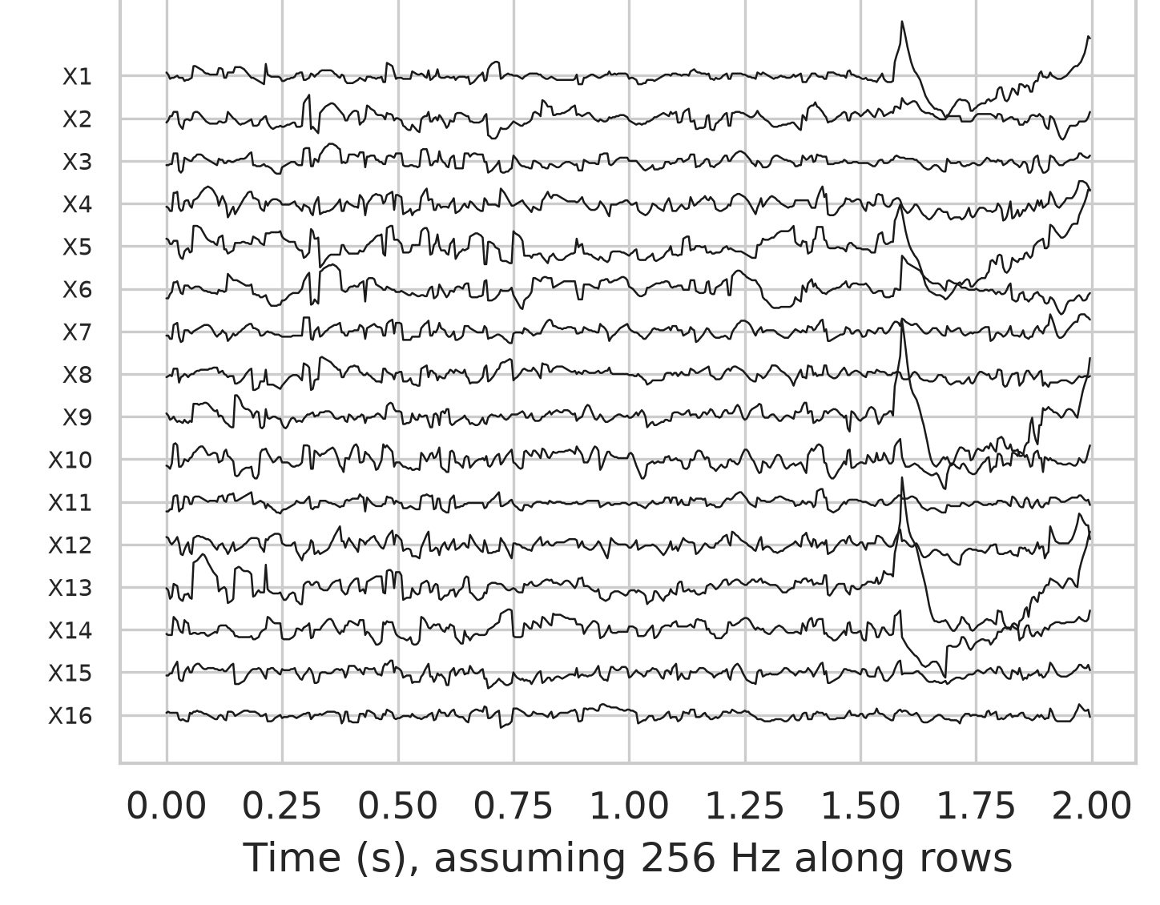
1. Introduction: Motivation
Epilepsy affects about 50 million people worldwide [4].
Visual EEG review is expert-intensive and slow.
Automated seizure-type classification could support clinicians.
Public benchmarks like BEED [1] drive models; their validity matters.
Fig. 1. BEED focal-seizure class: 512 consecutive rows drawn as 16 traces [1].
NIELIT Bio-AI Conclave 2026 · Track 5
3 / 15
Notes:
Speaker notes: Epilepsy affects about 50 million people worldwide. Visual EEG review is expert-intensive and slow, so automated seizure-type classification could support clinicians. Public benchmarks such as BEED drive which models get built, so their validity matters. The figure shows 512 consecutive rows of the BEED focal-seizure class drawn as 16 traces.
Sources: Epilepsy prevalence (about 50 million people worldwide) [4]: WHO epilepsy fact sheet, https://www.who.int/news-room/fact-sheets/detail/epilepsy; [1] Najmusseher N, Nizar Banu PK. BEED: Bangalore EEG Epilepsy Dataset [dataset]. UCI Machine Learning Repository. 2024. doi:10.24432/C5K33B; Figure: /workspace/beed/deliverables/code/figures/fig_examples.png, panel (b), cropped.

Slide 4
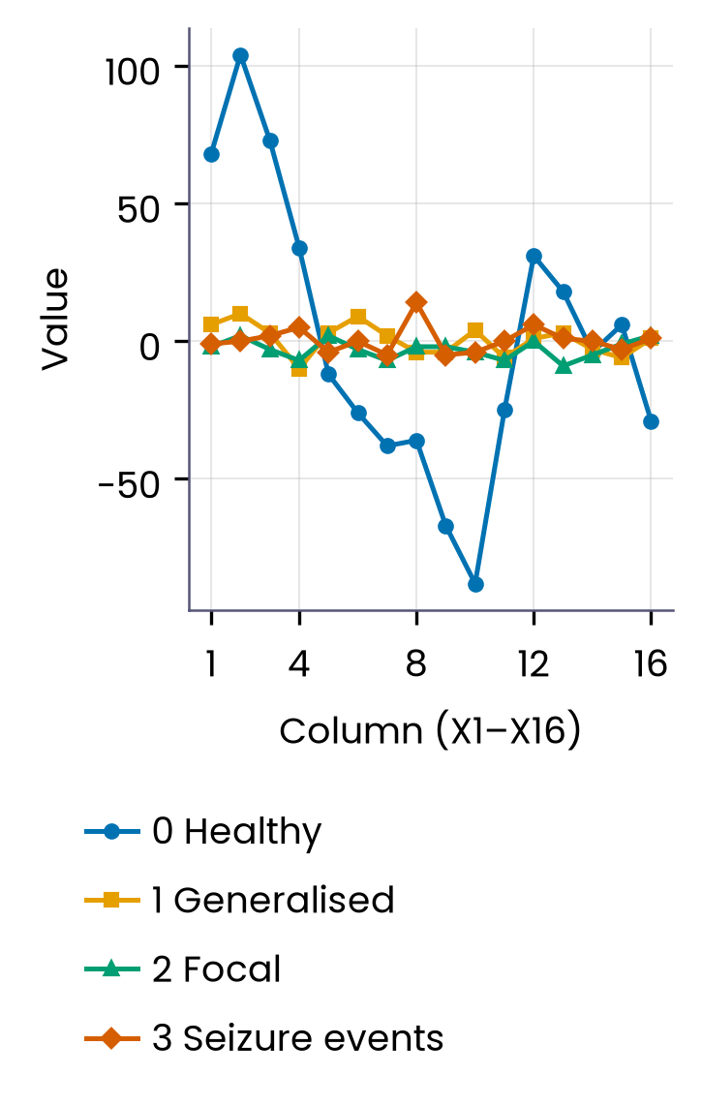
1. Introduction: The BEED Dataset
8,000 rows · 16 values per row (X1–X16) · 256 Hz, 16 channels [1]
0 · Healthy
1 · Generalised seizures
2,000 rows; documented as healthy adult subjects [1].
2,000 rows; seizures involving both hemispheres.
2 · Focal seizures
3 · Seizure events
Fig. 2. One BEED row per class; healthy rows show far larger amplitude.
2,000 rows; onset in a restricted brain region.
2,000 rows; events with blinking or staring behaviours.
NIELIT Bio-AI Conclave 2026 · Track 5
4 / 15
Notes:
Speaker notes: BEED is distributed as a single table of 8,000 rows, each holding 16 integer values labelled X1 to X16. There are four classes of 2,000 rows each: healthy, generalised seizures, focal seizures and seizure events with behaviours such as blinking or staring. The documentation describes 16-channel recordings at 256 Hz from a neurological centre in Bangalore. Note the much larger amplitude of the healthy row in the figure; we return to this in the audit.
Sources: [1] Najmusseher N, Nizar Banu PK. BEED: Bangalore EEG Epilepsy Dataset [dataset]. UCI Machine Learning Repository. 2024. doi:10.24432/C5K33B. Row/class counts, X1–X16, 256 Hz, class definitions: BEED_paper_camera_ready.docx (Introduction, Methods 3.1). Figure: redrawn for the slide from /workspace/beed/raw/BEED_Data.csv (4th row of each class, as in code/figures/fig_examples.png panel a) by figs/make_figs.py.

Slide 5
1. Introduction:
Research Question
Random row split
Standard practice in prior BEED studies.
Adjacent rows can land in train and test.
How well do models classify BEED seizure types when tested without leakage?
Sub-question: the origin of the healthy rows.
Leakage-safe block split
200-row blocks with 50-row gaps.
No near-duplicates across the split.
NIELIT Bio-AI Conclave 2026 · Track 5
5 / 15
Notes:
Speaker notes: Our central question is how well models classify the BEED seizure types once the test set is free of leakage. Most prior BEED work uses a random row split, so neighbouring rows from the same recording can sit on both sides of the split. We compare this with a leakage-safe protocol that holds out 200-row blocks separated by 50-row gaps, so no test row has a near-duplicate neighbour in training. Along the way we also ask where the healthy class comes from.
Sources: research questions and protocols — BEED_paper_camera_ready.docx (Introduction, Methods: random and blocked protocols).

Slide 6
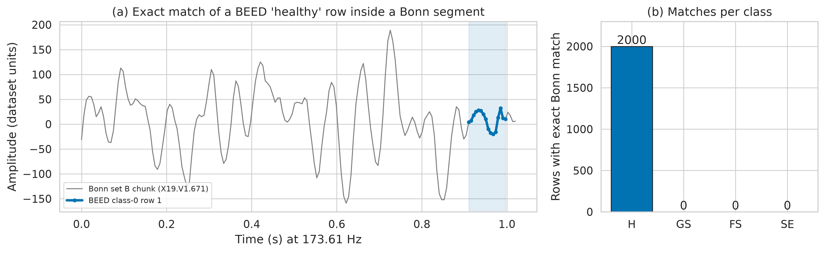
2. Dataset Audit:
Where the Healthy Class Comes From
Match
All 2,000 healthy rows match UCI data exactly [3]; classes 1–3 do not.
Source
Bonn set B, eyes closed, 173.61 Hz [2]; classes 1–3: 256 Hz.
Position
Every match lies at samples 159–174 of a one-second chunk.
Effect
A single smoothness threshold separates healthy rows (accuracy 0.997).
Fig. 3. A BEED healthy row identical to a Bonn set-B window (a); matches per class (b).
NIELIT Bio-AI Conclave 2026 · Track 5
6 / 15
Notes:
Speaker notes: When we searched for the healthy rows in older public data, every one of the 2,000 rows was identical to a 16-sample window of the UCI Epileptic Seizure Recognition file, which is derived from Bonn set B, healthy volunteers with eyes closed. Every match sits at the same position, samples 159 to 174 of a one-second chunk, and no row from the three seizure classes matches. The healthy class therefore appears to be taken from a different recording source, sampled at 173.61 Hz rather than 256 Hz. As a consequence, healthy and seizure rows can be told apart by recording source alone: one smoothness threshold reaches 0.997 accuracy.
Sources: [2] Andrzejak RG, Lehnertz K, Mormann F, Rieke C, David P, Elger CE. Physical Review E. 2001;64(6):061907. doi:10.1103/PhysRevE.64.061907. [3] Wu Q, Fokoue E. Epileptic Seizure Recognition data set [dataset]. UCI Machine Learning Repository. 2017. Match results, positions, 173.61 Hz, 0.997 threshold accuracy: BEED_paper_camera_ready.docx (Results 4.2, 4.4; paper Fig. 2). Figure: code/figures/fig_provenance.png.

Slide 7
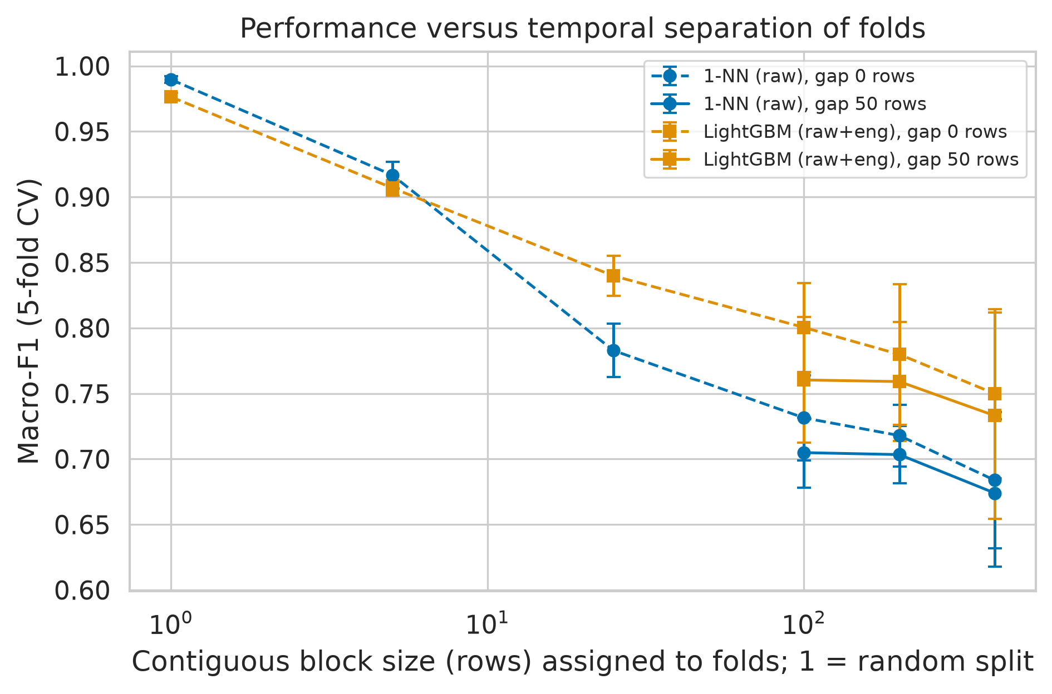
2. Dataset Audit:
Temporal Leakage
Consecutive seizure-class rows are adjacent time points, hence near-duplicates.
Random split
88–95% of seizure test rows have their neighbouring row in training.
Fig. 4. Macro-F1 falls as folds use longer row blocks.
Implication
Random-split scores measure interpolation, not generalisation.
NIELIT Bio-AI Conclave 2026 · Track 5
7 / 15
Notes:
Speaker notes: In the three seizure classes, each row is one time point of a continuous recording, so neighbouring rows are almost identical. With a random row split, between 88 and 95 percent of seizure test rows have their immediate neighbour in the training set. A classifier can then simply look up the neighbour, so random-split scores measure interpolation rather than generalisation. The figure shows macro-F1 falling steadily as folds are built from longer contiguous blocks.
Sources: leakage_nearest_neighbour.csv (nn_within_1_row 0.878–0.953 for classes 1–3); BEED_paper_camera_ready.docx Results 4.3 (87.8%–95.2%); figure code/figures/fig_block_curve.png.

Slide 8
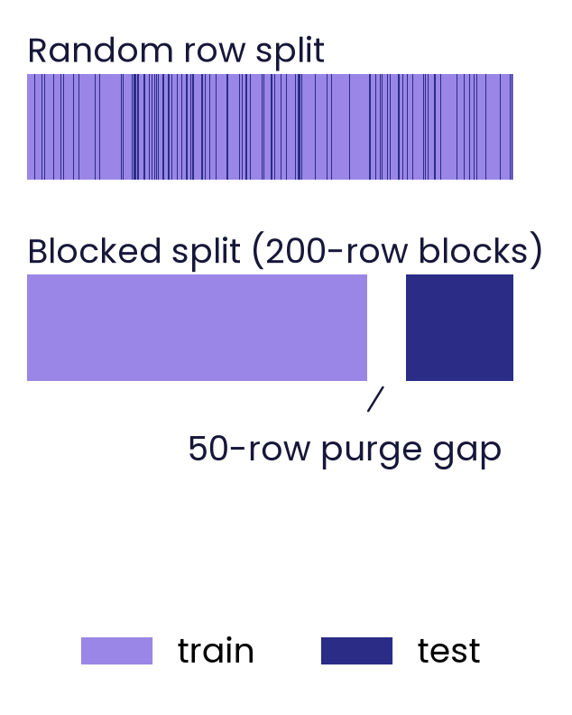
3. Methodology
Nested tuning on macro-F1; each test set used once
Splits
Models
Random 80/20 vs blocked hold-out: 200-row blocks, 50-row purge; 5×2 CV.
LR, kNN, SVM-RBF, RF, XGBoost, LightGBM; MLP, 1D-CNN, BiLSTM, Transformer.
Fig. 5. Schematic: random versus blocked hold-out with a purge gap.
Statistics
Metrics
Cluster-bootstrap 95% CIs; corrected resampled t-test; Friedman + Nemenyi.
Macro-F1 (primary), accuracy, Cohen’s kappa, AUC, calibration (ECE).
NIELIT Bio-AI Conclave 2026 · Track 5
8 / 15
Notes:
Speaker notes: We compare two protocols. The random protocol is a stratified 80/20 row split, as in most prior work; the blocked protocol holds out whole 200-row blocks, or whole Bonn segments for the healthy class, and purges training rows within 50 rows of any test row. We benchmark six classical models and four small deep networks, with nested tuning on macro-F1, and compare them with cluster-bootstrap confidence intervals, corrected resampled t-tests and Friedman plus Nemenyi tests. Macro-F1 is the primary metric, with accuracy, kappa, AUC and calibration error alongside.
Sources: BEED_paper_camera_ready.docx Methods 3.3 (protocols), 3.5 (models: LR, kNN, SVM-RBF, RF, XGBoost, LightGBM + majority baseline; MLP, 1D-CNN, BiLSTM, Transformer), 3.6 (metrics, bootstrap CIs, Nadeau–Bengio corrected t-test with Holm, Friedman + Nemenyi). Figure: schematic drawn for this talk (figs/make_figs.py).

Slide 9
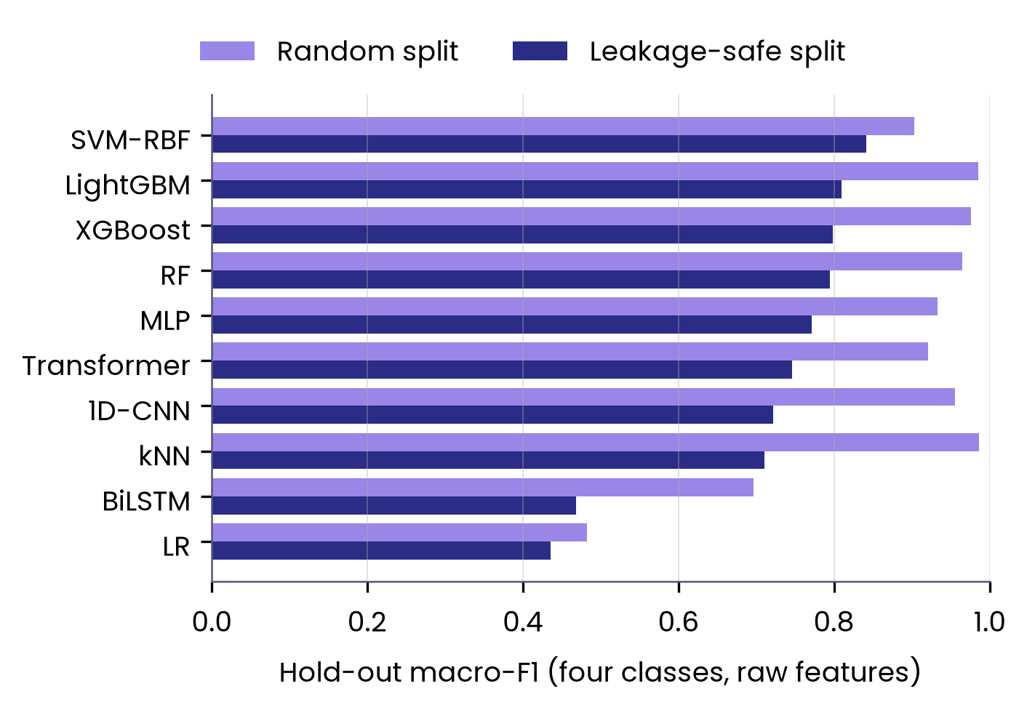
4. Results: Random vs Leakage-Safe Split
 | Random | Leakage-safe
4-class macro-F1 | 0.986 | 0.842
95% CI | 0.980–0.992 | 0.800–0.880
Accuracy | 0.986 | 0.844
Cohen’s kappa | 0.982 | 0.792
3-class macro-F1 | 0.990 | 0.776
Median ECE | 0.029 | 0.093
Best models: kNN (random), SVM-RBF (leakage-safe); raw features. 3-class: seizure types only.
Fig. 6. Four-class hold-out macro-F1 per model, raw features, by split.
NIELIT Bio-AI Conclave 2026 · Track 5
9 / 15
Notes:
Speaker notes: Under the random split the best model, kNN, reaches a macro-F1 of 0.986; under the leakage-safe split the best model, SVM-RBF, reaches 0.842, with a 95% confidence interval of 0.800 to 0.880. Accuracy falls from 0.986 to 0.844 and kappa from 0.982 to 0.792. For the three seizure types alone, the drop is larger, from 0.990 to 0.776, and the median calibration error triples, from 0.029 to 0.093. Every model in the chart loses performance, and the ranking of models changes.
Sources: code/results/holdout_metrics.csv (task 4class/3class, features raw; kNN random macro-F1 0.9863, acc 0.9863, kappa 0.9817, cluster CI 0.980–0.992; SVM-RBF blocked 0.8415, CI 0.7998–0.8801, acc 0.8437, kappa 0.7915; 3class kNN random 0.9900, SVM-RBF blocked 0.7756; median ECE over non-baseline 4-class models, all feature sets: 0.0292 random, 0.0932 blocked). BEED_paper_camera_ready.docx Results 4.4–4.6, Table 3. Figure drawn from holdout_metrics.csv (figs/make_figs.py).

Slide 10
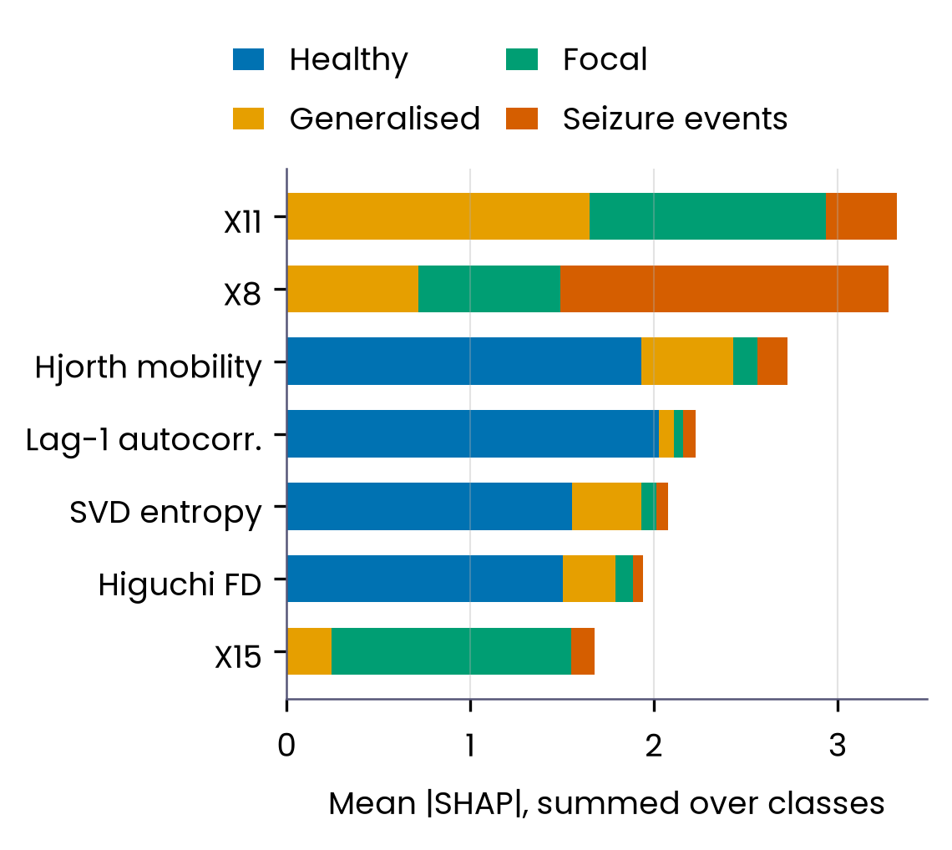
4. Results:
What the Models Look At
Leakage-safe feature importance
Seizure types: raw voltages of channels X11, X8 and X15.
Healthy class: smoothness, e.g. Hjorth mobility.
Healthy class: a recording-source shortcut
Healthy vs seizure: macro-F1 ≥ 0.999 under both splits.
One lag-1 autocorrelation threshold: accuracy 0.997.
Fig. 7. Top SHAP features, LightGBM, four classes, leakage-safe split.
NIELIT Bio-AI Conclave 2026 · Track 5
10 / 15
Notes:
Speaker notes: Under the leakage-safe split, the seizure classes are separated mainly by the raw voltages of particular channels, X11, X8 and X15, that is, by the spatial pattern across electrodes. The healthy class is separated almost entirely by smoothness descriptors such as Hjorth mobility and lag-1 autocorrelation. Healthy versus seizure is solved with macro-F1 of at least 0.999 under both splits, but a single threshold on lag-1 autocorrelation alone reaches 0.997 accuracy. This is a recording-source shortcut, not a clinical signal.
Sources: shap_4class_blocked.csv (top summed |SHAP|: X11 3.32, X8 3.28, t_hjorth_mob 2.73, t_lag1_ac 2.23, n_svd_entropy 2.08, n_higuchi_fd 1.94, X15 1.68); shap/Results 4.7 of BEED_paper_camera_ready.docx (3-class blocked leaders X11, X8, X15, X12, X6); holdout_metrics.csv binary blocked best macro-F1 0.9992; shortcut_stumps.csv blocked t_lag1_ac accuracy 0.9975. Figure redrawn from shap_4class_blocked.csv (figs/make_fig7.py).

Slide 11
4. Results: Lightweight Edge Model
Model (raw 16 values) | Parameters | Size (kB) | Latency (ms) | Macro-F1*
MLP | 11,076 | 43 | 0.077 | 0.770
1D-CNN | 19,524 | 76 | 0.145 | 0.714
Transformer | 17,796 | 70 | 0.249 | 0.745
LightGBM (raw+eng.) | 62,720 | ≈735 | 4.350 | 0.794
*Leakage-safe hold-out. Latency: median of 500 single-sample runs, one Xeon vCPU thread.
The MLP is far below the 3.9 ms sampling interval at 256 Hz: suited to edge devices.
Best leakage-safe hold-out model, SVM-RBF (0.842), was not profiled.
5×2 blocked CV: best LightGBM 0.767 ± 0.057; Friedman test p < 0.001.
NIELIT Bio-AI Conclave 2026 · Track 5
11 / 15
Notes:
Speaker notes: For deployment we profiled the small models on a single CPU thread. The MLP has 11,076 parameters, about 43 kB, and classifies one 16-value sample in 0.077 ms, with a leakage-safe macro-F1 of 0.770. That is far below the 3.9 ms between samples at 256 Hz, so it is suitable for wearable or edge hardware; LightGBM scores slightly higher but needs 4.35 ms because of feature extraction. In repeated blocked cross-validation, LightGBM had the best mean macro-F1, 0.767 plus or minus 0.057, and the Friedman test rejected equal performance across models.
Sources: edge_deployment.csv (MLP 11,076 params, 43.27 kB fp32, 0.0771 ms, macro-F1 0.7700; 1D-CNN 19,524 / 76.3 kB / 0.145 ms / 0.714; Transformer 17,796 / 69.5 kB / 0.249 ms / 0.745; LightGBM 62,720 / 735 kB (approx.) / 4.35 ms / 0.794). BEED_paper_camera_ready.docx 3.8 and Table 5 note (median of 500 single-sample predictions on one Intel Xeon virtual CPU thread; deep models retrained for profiling, so F1 may differ slightly from Table 3). cv_summary.csv 4class blocked LightGBM 0.7665 ± 0.0565; stats_friedman.csv 4class blocked chi2 57.2, p = 5.4e-10. SVM-RBF 0.842: holdout_metrics.csv.

Slide 12
Data
5. Discussion:
Limitations
No subject IDs: patient-independent testing is impossible.
Recording and class are confounded.
Healthy class from another source, sampled at 173.61 Hz.
What remains valid
The blocked benchmark is a lower-leakage estimate of generalisation to unseen time within the same recordings.
Scope
Classes 1–3 not checked against other public databases.
Single dataset; no external test.
NIELIT Bio-AI Conclave 2026 · Track 5
12 / 15
Notes:
Speaker notes: The public file has no subject identifiers, so no protocol, including ours, can test generalisation to new patients, and recording identity is confounded with class. Because the healthy rows come from a different source sampled at 173.61 Hz rather than 256 Hz, healthy-versus-seizure results say little about clinical detection. We searched only the Bonn data, so classes 1 to 3 were not checked against other public databases, and this is a single-dataset study. What remains valid is the blocked benchmark as a lower-leakage estimate of generalisation to unseen time within the same recordings.
Sources: BEED_paper_camera_ready.docx Discussion 5.x 'Limitations' paragraph (no subject identifiers; blocked protocol measures generalisation to unseen time within recordings; provenance match covers only the Bonn file; future cross-dataset transfer e.g. CHB-MIT); Results 4.2 (173.61 Hz Bonn vs 256 Hz).

Slide 13
6. Conclusion: Takeaways and Future Work
Takeaways
Future work
Healthy rows identical to Bonn set B windows [2], [3]: a source shortcut.
Subject IDs for patient-independent tests.
Random splits leak: macro-F1 0.986 vs 0.842 (3-class 0.990 vs 0.776).
Same-source healthy recordings.
Report blocked splits as the BEED benchmark.
Cross-dataset validation on public EEG sets.
An 11k-parameter MLP (0.077 ms per sample) is edge-ready.
Clinical and wearable deployment studies.
NIELIT Bio-AI Conclave 2026 · Track 5
13 / 15
Notes:
Speaker notes: To conclude: the healthy class of BEED is identical to windows of Bonn set B, so healthy-versus-seizure scores largely reflect recording source. Random row splits leak information; under a leakage-safe split the best four-class macro-F1 falls from 0.986 to 0.842, and for the three seizure types from 0.990 to 0.776, so blocked splits should be reported as the benchmark. A small MLP with about 11 thousand parameters runs in 0.077 ms per sample and is ready for edge hardware. Next steps are subject identifiers for patient-independent testing, same-source healthy recordings, cross-dataset validation and clinical or wearable deployment studies.
Sources: holdout_metrics.csv (0.986/0.842; 3-class 0.990/0.776); edge_deployment.csv (11,076 params, 0.077 ms); provenance results, BEED_paper_camera_ready.docx Results 4.2 and Discussion/Conclusion; references [2] Andrzejak et al. 2001, [3] Wu & Fokoue 2017.

Slide 14
References
[1] Najmusseher N, Nizar Banu PK. BEED: Bangalore EEG Epilepsy Dataset [dataset]. UCI Machine Learning Repository. 2024. doi:10.24432/C5K33B.
[2] Andrzejak RG, Lehnertz K, Mormann F, Rieke C, David P, Elger CE. Indications of nonlinear deterministic and finite-dimensional structures in time series of brain electrical activity: dependence on recording region and brain state. Physical Review E. 2001;64(6):061907. doi:10.1103/PhysRevE.64.061907.
[3] Wu Q, Fokoue E. Epileptic Seizure Recognition data set [dataset]. UCI Machine Learning Repository. 2017. Copy distributed by the creators at github.com/QiuyiWu/Epileptic-Seizure-Recognition-Data (accessed 7 October 2026).
[4] World Health Organization. Epilepsy [fact sheet]. who.int/news-room/fact-sheets/detail/epilepsy (accessed 8 October 2026).
Complete reference list: see the full paper.
NIELIT Bio-AI Conclave 2026 · Track 5
14 / 15
Notes:
Speaker notes: These are the four sources cited on the slides: the BEED dataset itself, the original Bonn EEG study, the UCI Epileptic Seizure Recognition file derived from it, and the WHO epilepsy fact sheet. The full reference list, including the methods and statistics references, is in the paper.
Sources: [1]-[3] exact text from BEED_paper_camera_ready.docx reference list (paper refs [7], [5], [18]); [4] WHO fact sheet, https://www.who.int/news-room/fact-sheets/detail/epilepsy, checked 8 October 2026 ('affecting around 50 million people worldwide').

Slide 15
THANK YOU
FOR YOUR ATTENTION
Questions?
Er. Rishabh Aryan
M.Tech (Artificial Intelligence and Data Science), Department of Computer Science and Engineering
Indian Institute of Information Technology, Bhagalpur (Bihar)
E-mail: rishabh.250201011@iiitbh.ac.in
ORCID ID: https://orcid.org/0009-0004-7595-9440
NIELIT Bio-AI Conclave 2026 · Track 5
15 / 15
Notes:
Speaker notes: Thank you for your attention. I am happy to take questions, and the code and full results are described in the paper. My contact details are on the slide.
Sources: presenter and contact details as supplied by the presenter.

